Slide 1
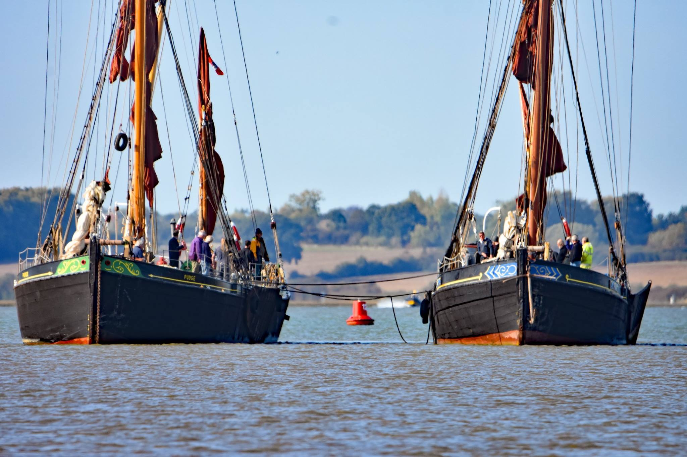
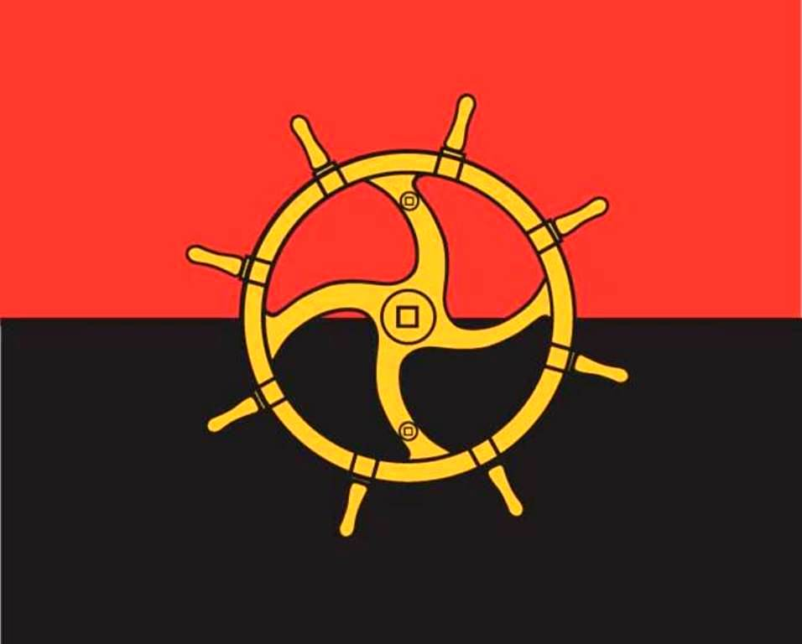
Thames Sailing Barges
Cargo and Passage
Geography
Thames Sailing Barge Trust

Slide 2
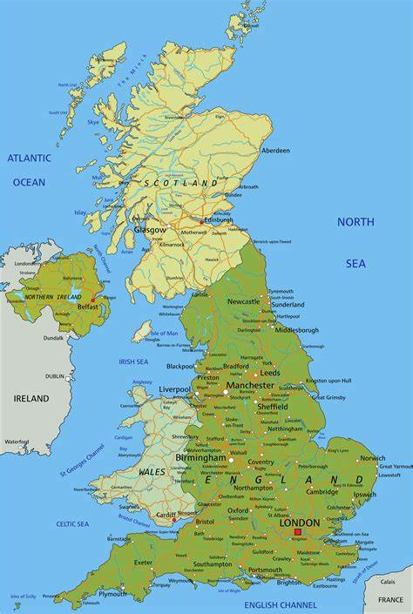
Notes:
Who can identify where abouts we are on this map?

Slide 3
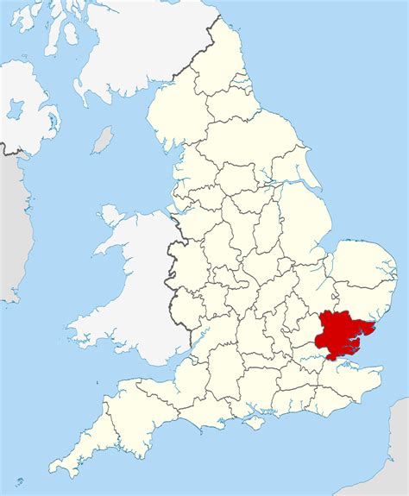
Notes:
Which county is this? (Essex)

Slide 4
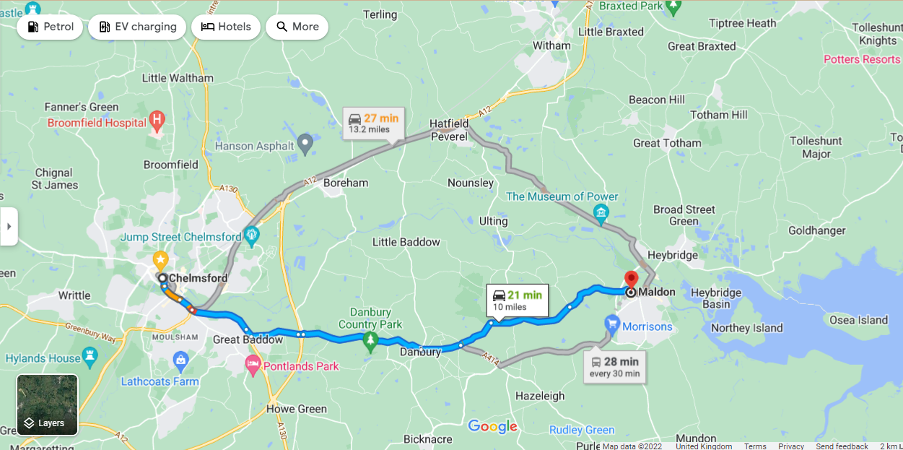
Notes:
Why is Chelmsford identified? (Capital city of Essex)

Slide 5
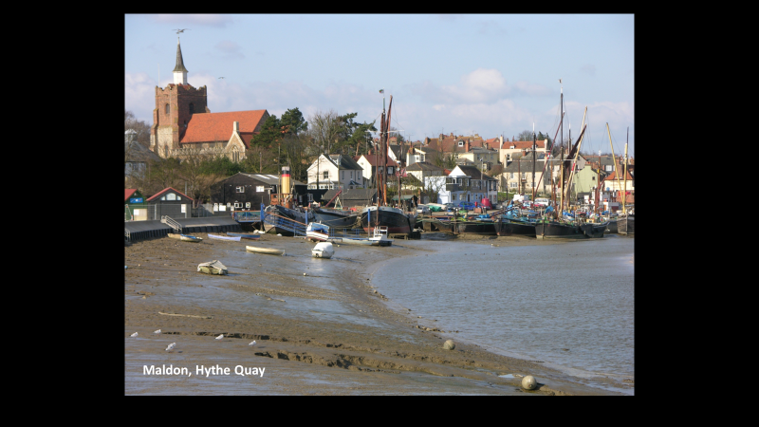

Slide 6
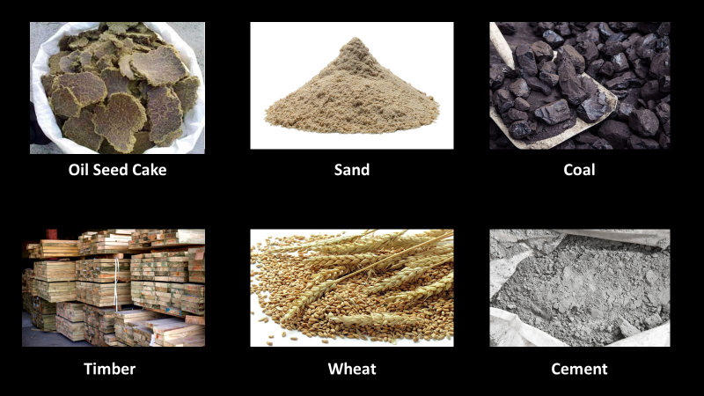

Slide 8
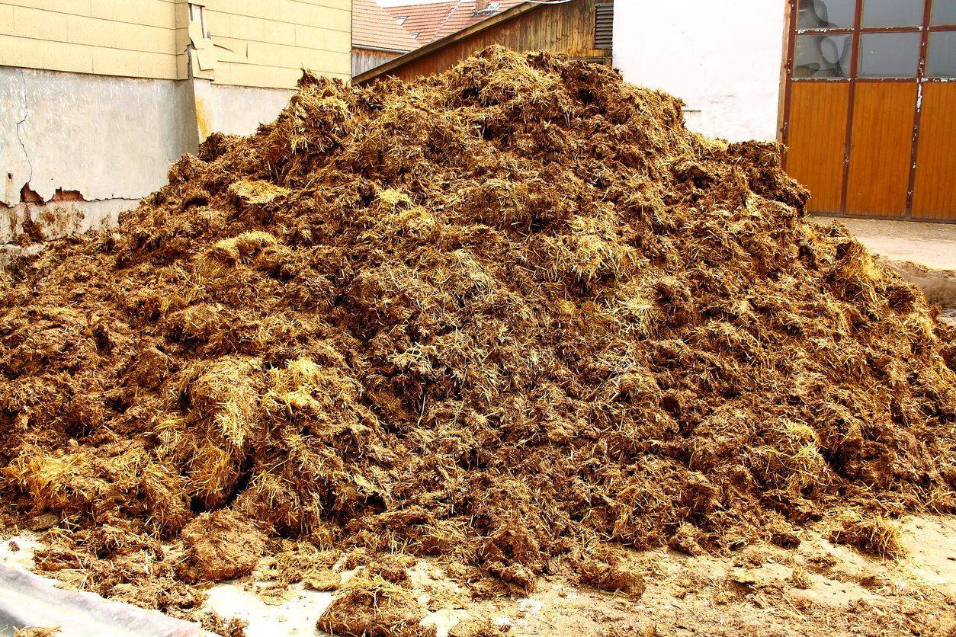
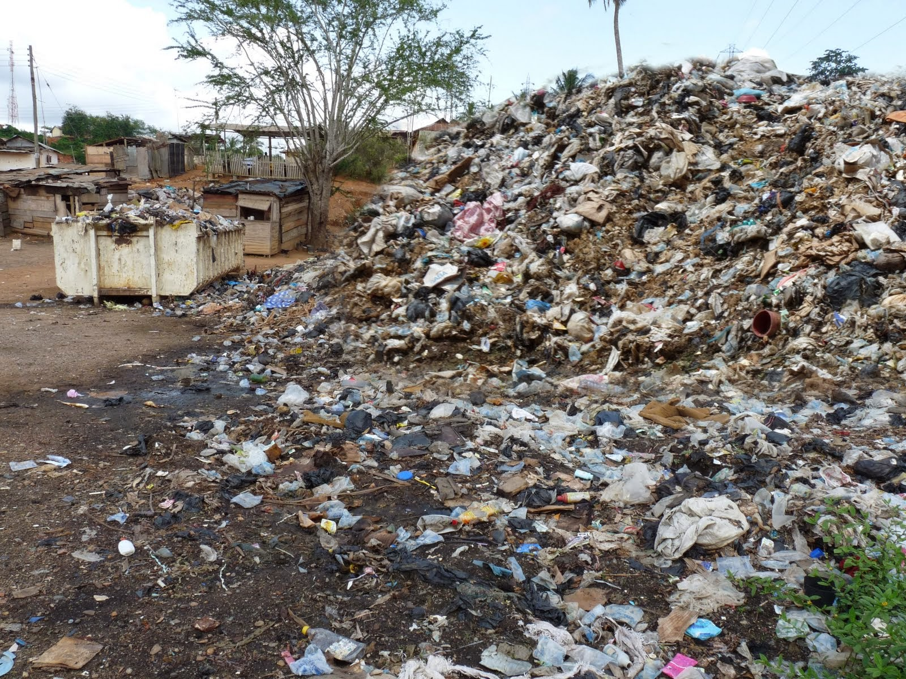
Manure
Rubbish

Slide 9
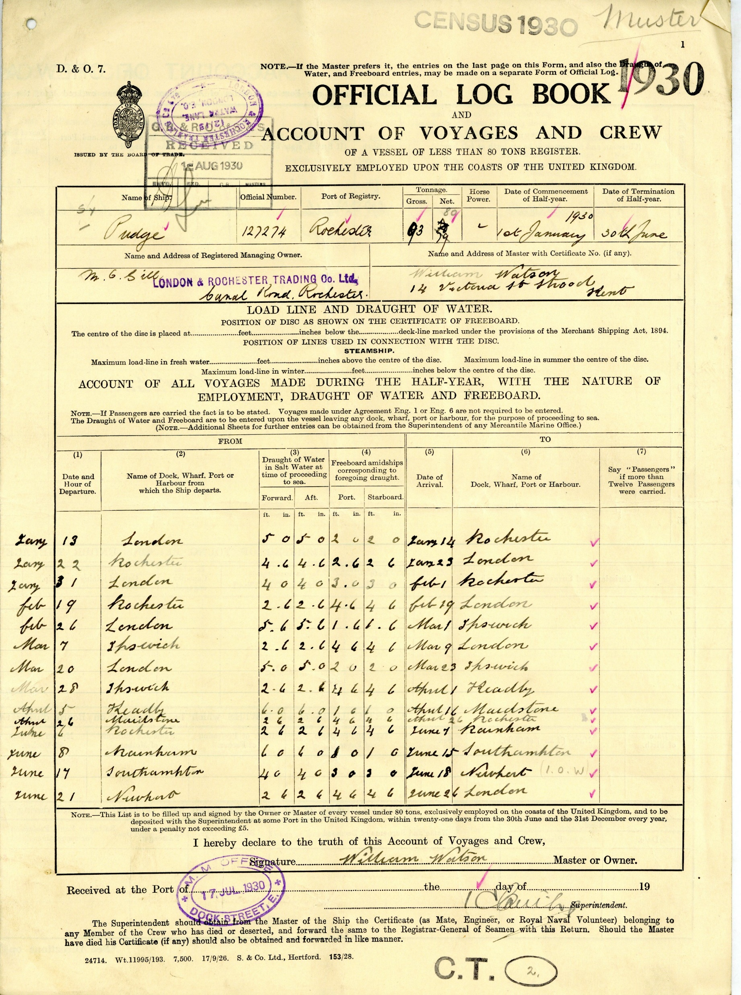
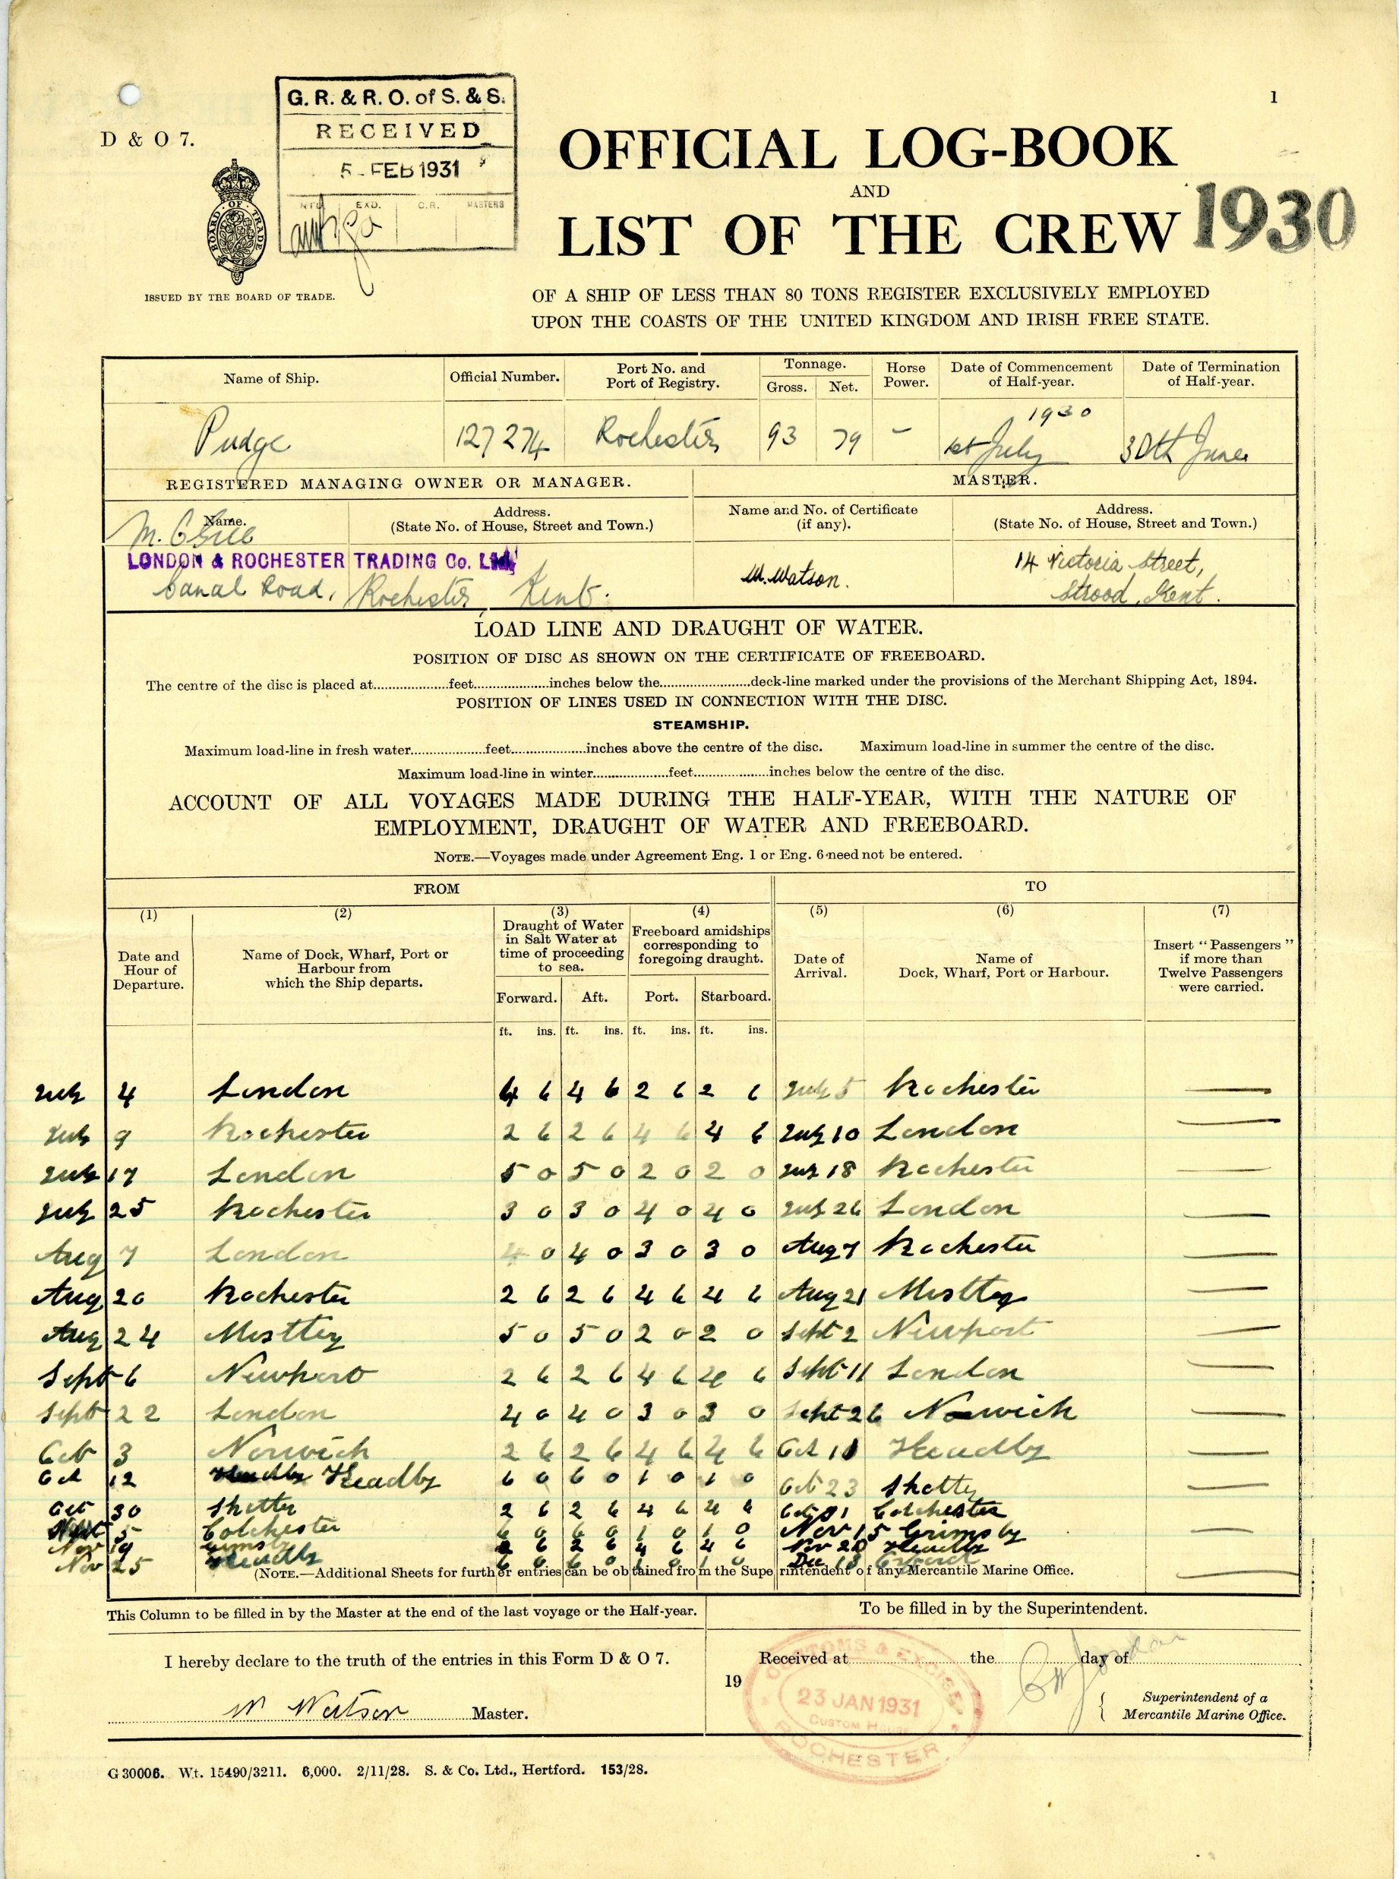
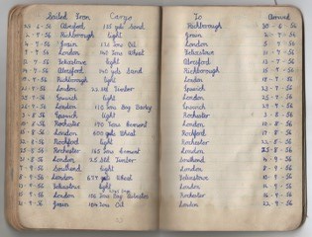
Log Books which show places the sailing barges visited
Pudge 1930 1st half-year
Pudge 1930 2nd half-year
Cargo records for Pudge 1956 kept by the Skipper of the barge

Slide 10
People

Slide 12
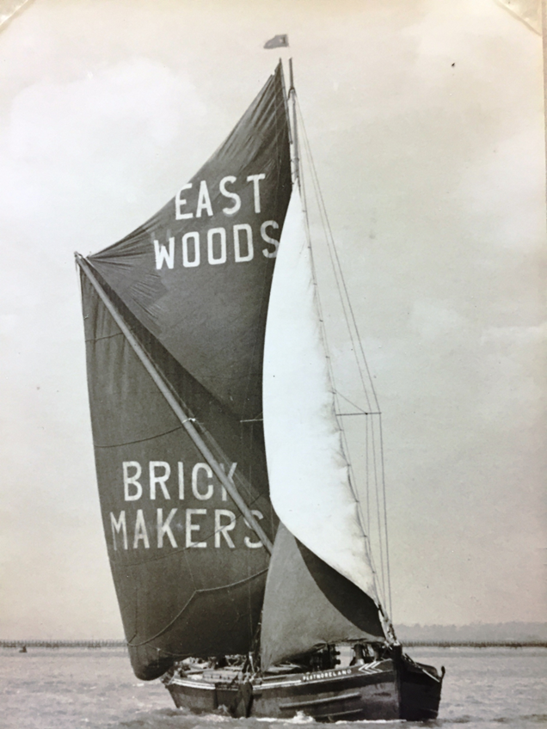
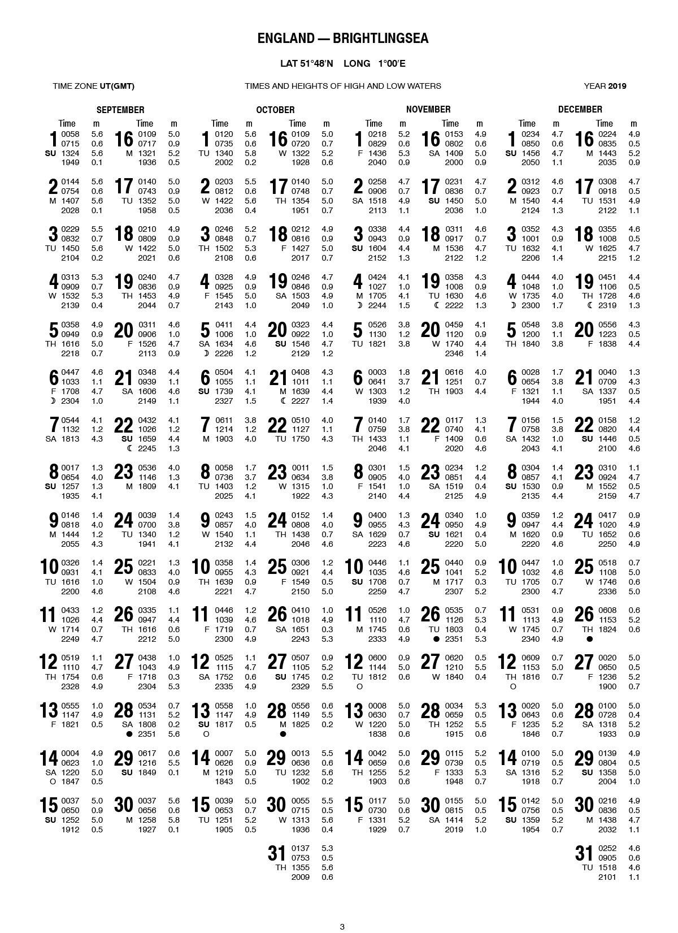
Their main means of power were their sails which collected the wind to allow them to move from place to place. They weren’t built with engines. Barges are reliant on the tide to be able to make their passage.
Tide Tables

Slide 13
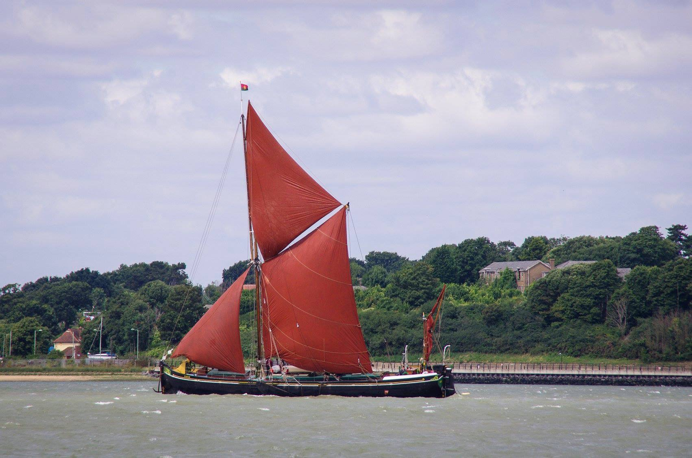

Slide 14
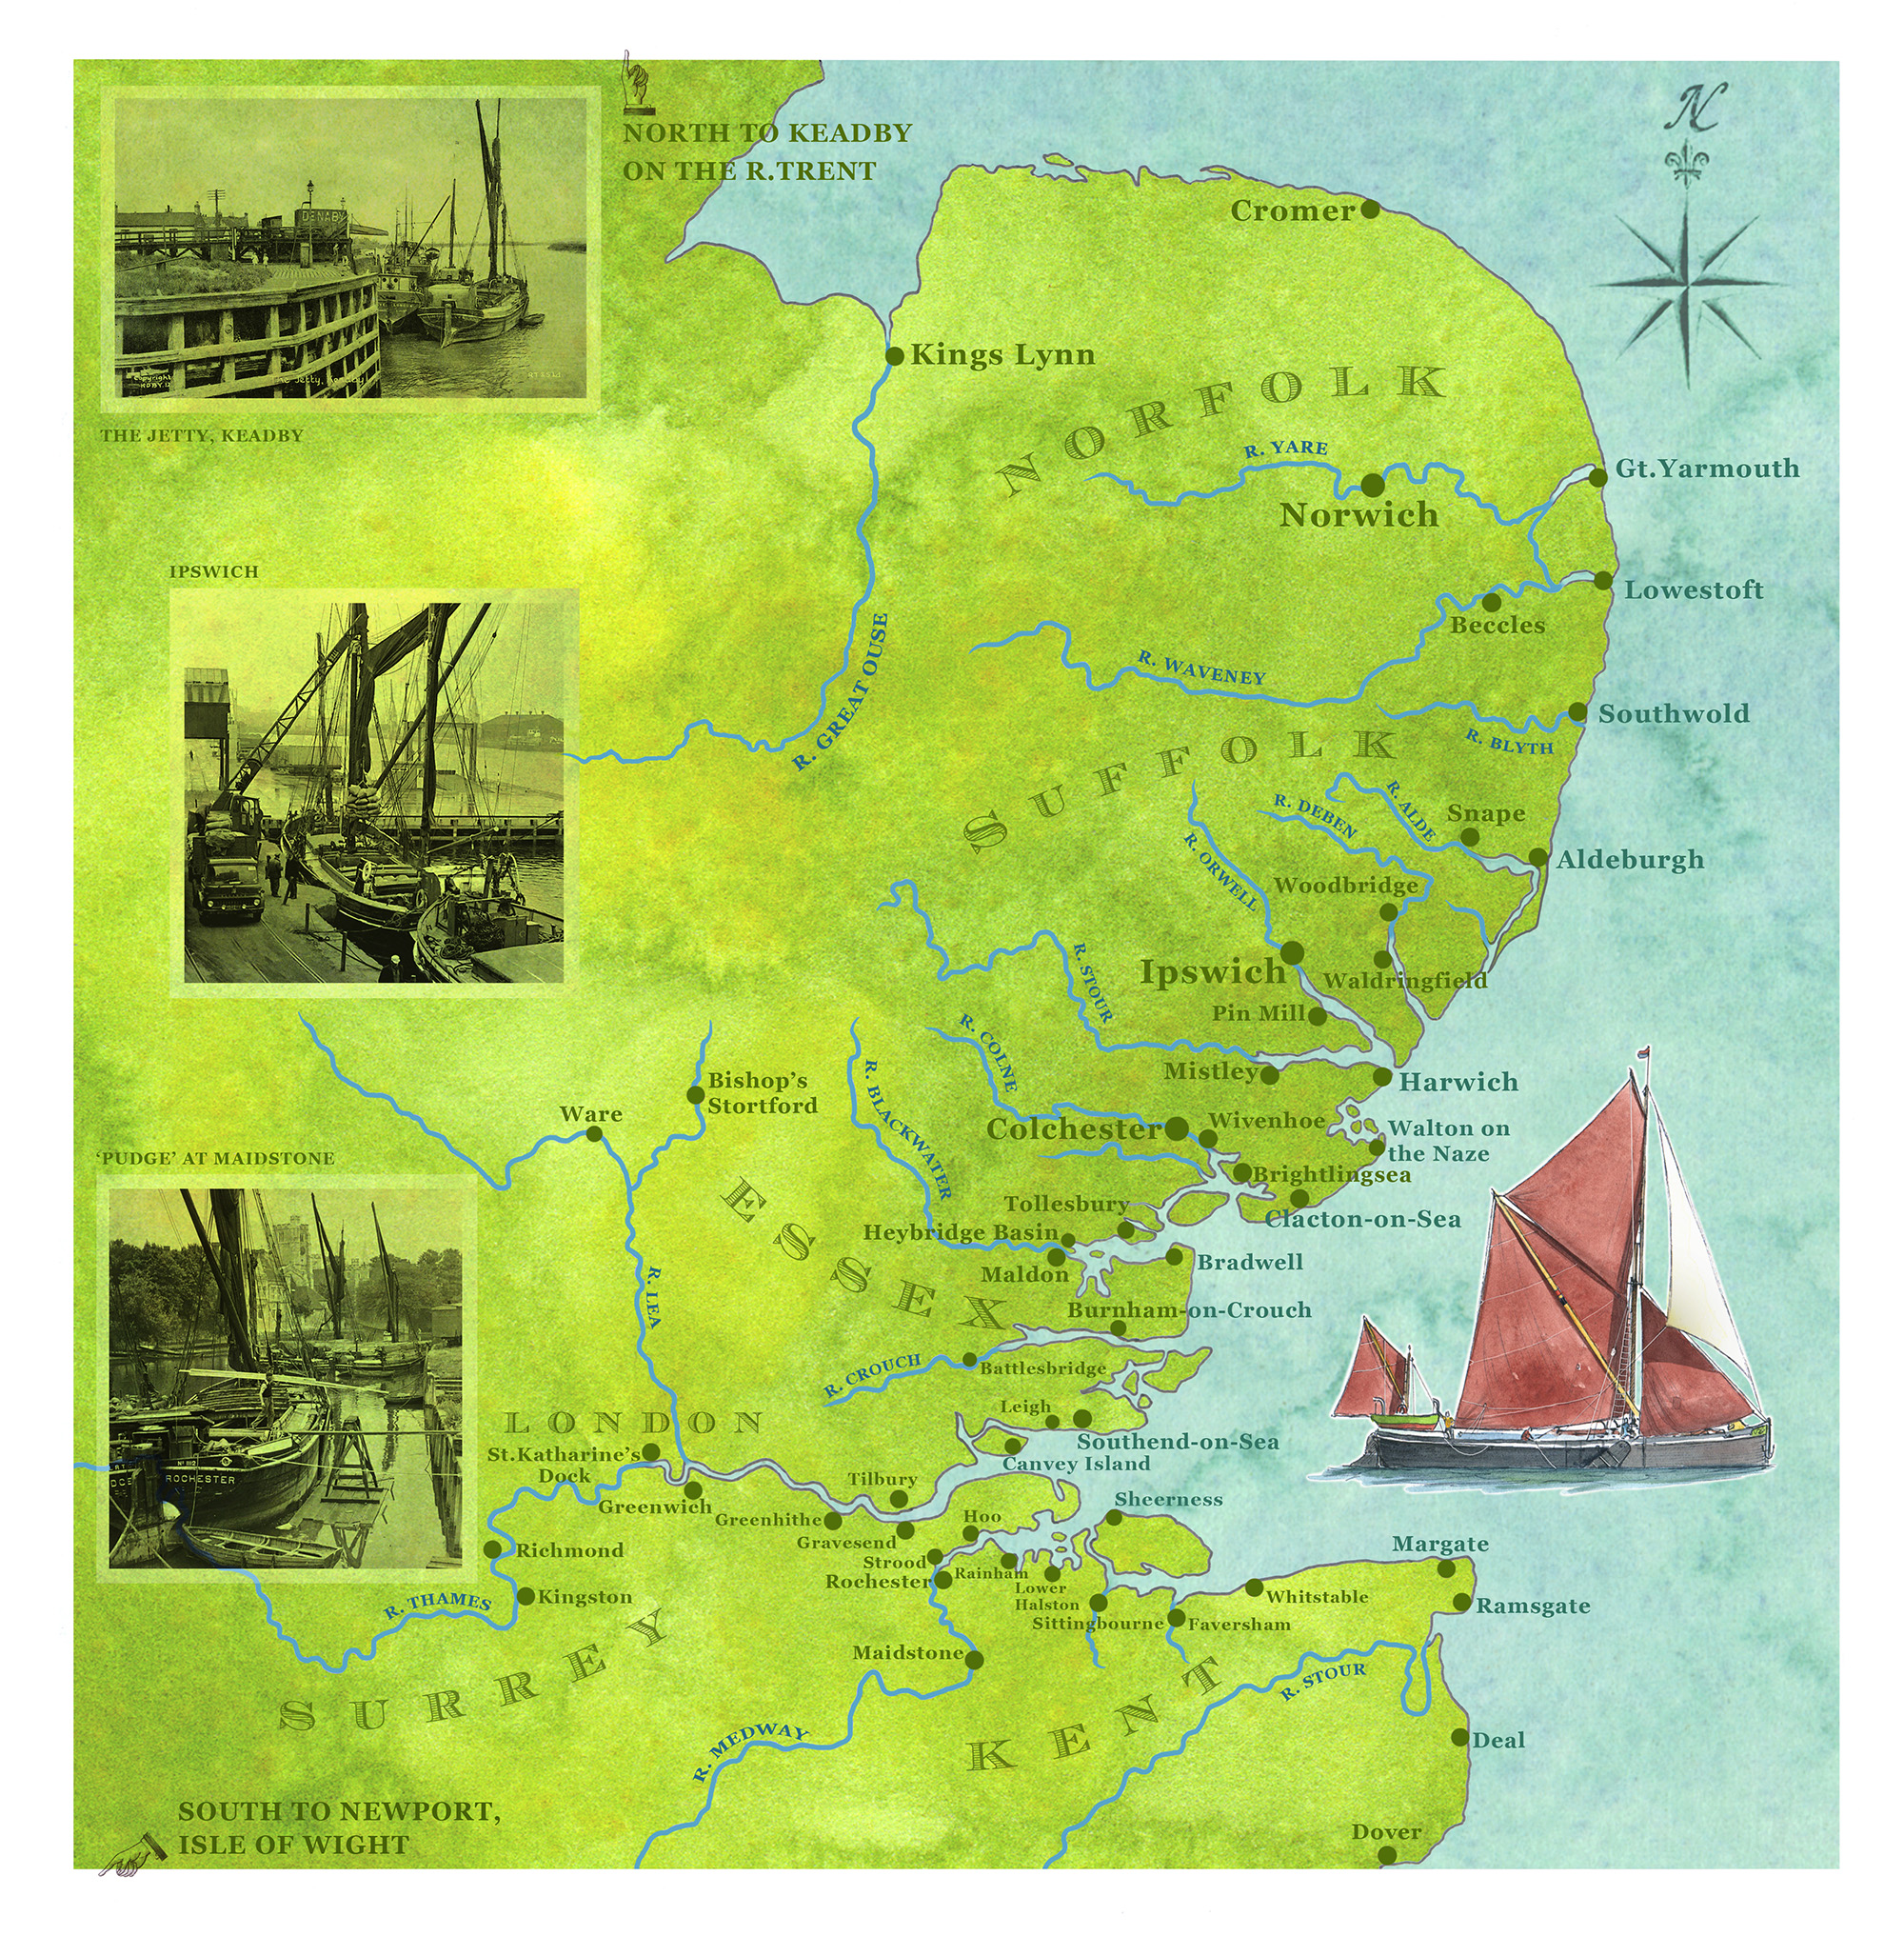

Slide 15
Activity
Using the cargo cards, find the places on the map and use the colour on the card to draw the route.
Remember to follow the rivers and the water and not over land!

